Slide 1

Decoding Diabetes
Predictive Models and Insights Using Machine Learning
Professor: 안용길
Presents
Braian Plaku (브라이언 플라쿠)

Slide 2
Introduction
Diabetes is one of the most prevalent chronic diseases, affecting millions globally. This project aims to predict the likelihood of an individual having diabetes using the Behavioral Risk Factor Surveillance System (BRFSS) dataset from Kaggle.
The focus will be on understanding which factors contribute the most to diabetes risk and developing machine learning models to predict diabetes based on survey responses.
Dependent Variable Y: Diabetes_012
(0) no diabetes or only during pregnancy
(1) prediabetes
(2) diabetes
Dependent Variable X: 21 variables in the dataset
BMI
GenHlth
HighBP
HighChol
HeartDiseaseorAttack
Age
Education
Smoker
Veggies
NoDocbcCost
Income
Education
Fruits
PhysActivity
Stroke
PhysHlth
MentHlth
Sex
DiffWalk
AnyHealthcare, CholCheck

Slide 3


Digging deeper into the Data
Source:
CDC (Centers for Disease Control and Prevention) Behavioral Risk Factor Surveillance System, [LINK]
ANNUAL, uniform, state-specific data on preventive health practices and risk behaviors
Year 2011, extracted on Kaggle from CDC itself [LINK]
Original Data, in ‘csv’ format, 253,680 survey responses
Alex Teboul (Data Scientist), based on Building Risk Prediction Models for Type 2 Diabetes Using Machine Learning Techniques on Kaggle [LINK]
The data was cleaned into a useable format for machine learning alogrithms, reduction was made from 330 features (dependent variables) onto 21 variables
Link to his Notebook can be found here: [LINK]
Alex Teboul

Slide 4
Shaping the Data: Preprocessing & Preparation
Target Variable Binarization
Diabetes_012
(0) no diabetes or only during pregnancy
}
(0) no diabetes or only during pregnancy
(1) prediabetes
}
(1) prediabetes or diabetes
(2) diabetes
allows the models to focus on a simpler task!
Categorical vs. Continuous dependent variables
and splitting of the data into Training and Testing Sets…
Training the models → …

Slide 5
Key Traits of the two chosen Models
two models implemented
Random Forest
Logistic Regression
Builds multiple decision trees and combines their predictions
Provides feature importance, which tells us which factors are most important in predicting diabetes
Better suited for capturing complex patterns and interactions between features
Assigns weights (coefficients) to each feature, making it easy to interpret how each feature affects diabetes risk
Simple and more interpretable, but may not capture complex patterns as well as Random Forest

Slide 6
Model Training in Action
two models implemented
Random Forest
Logistic Regression
Splitted Training and Testing Sets
Built Random Forest Model
estimating 100 trees
Fit & trained the model
Predicted the data
Evaluated the model
Analyzed Feature Importance
Plotted the results visually
Splitted Training and Testing Sets
Built Logic Regression Model
with 1000 iterations
Fit & trained the model
Predicted the data
Evaluated the model
Plotted the results visually

Slide 7
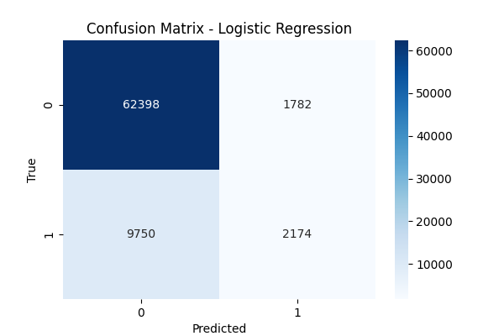
Outcome Review
Logistic Regression: Confusion Matrix
Breakdown of true and false positives and negatives
Correctly predicted
62,398 negatives
2174 positives
Incorrectly flagged
9,750 negatives
1,782 positives
Why? No undersampling, more data…

Slide 8
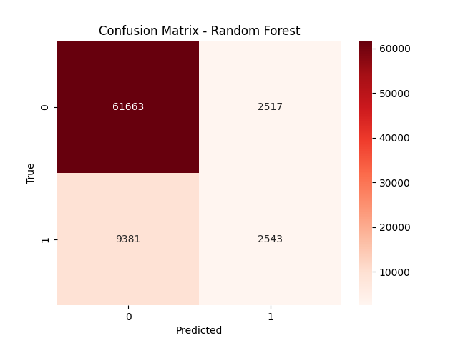
Outcome Review
Random Forest: Confusion Matrix
Breakdown of true and false positives and negatives
Correctly predicted
61,633 negatives
2,543 positives
Incorrectly flagged
9,381 negatives
2,517 positives
Why? No undersampling, more data…

Slide 9
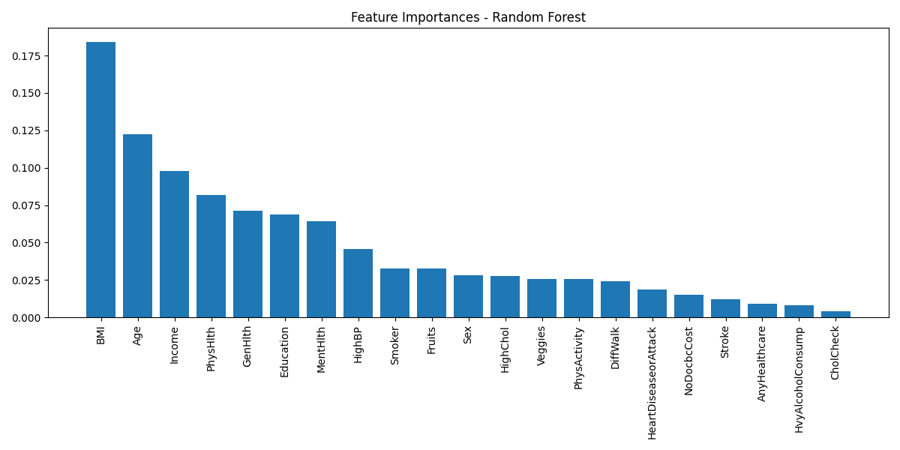
Outcome Review
Random Forest: Feature Importance

Slide 10
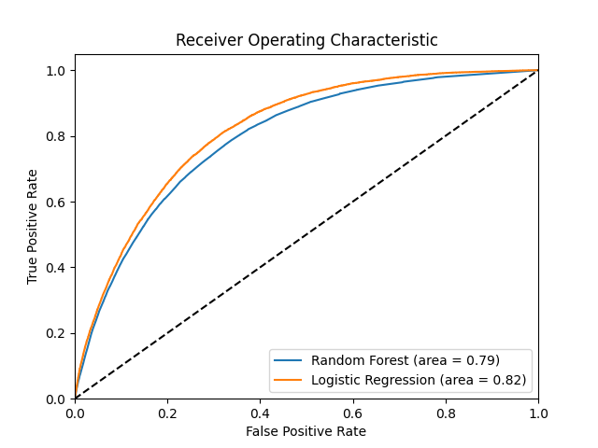
Outcome Review
Conclusion: Model Evaluation
Random Forest
Accuracy: 0.8436613055818354, Precision: 0.5025691699604743, ROC-AUC: 0.7938238511769095
Logistic Regression
Accuracy: 0.848470514033428, Precision: 0.5495449949443882, ROC-AUC: 0.8174917578129859
Logistic Regression
more interpretable
slightly higher performance
overall low precision (false positives)
Random Forest
valuable insights into feature importance
less accurate
overall low precision (false positives)

Slide 11

Literature
Literature
From the Web
Dataset:
Centers for Disease Control and Prevention:
https://www.cdc.gov/brfss/annual_data/annual_data.htm
Kaggle Datasets:
https://www.kaggle.com/datasets/cdc/behavioral-risk-factor-surveillance-system
https://www.kaggle.com/datasets/alexteboul/diabetes-health-indicators-dataset
Material:
Statistical Learning with Python, Stanford Online
https://www.youtube.com/playlist?list=PLoROMvodv4rPP6braWoRt5UCXYZ71GZIQ
Python Library Scikit:
https://scikit-learn.org/
More on Random Forest:
https://www.geeksforgeeks.org/random-forest-algorithm-in-machine-learning/

Slide 12
Thank you
for your attention!

